Slide 1
Data Analysis, Interpretation and Presentation
Sara Muneeb
sara.muneeb@cuilahore.edu.pk
Computer Science Department

Slide 2
Introduction
Qualitative and quantitative
Mix methods
Ratio, averages, percentages
Data cleansing
Investigator beliefs and biases
Claims that go beyond data
Support conclusion by results

Slide 3
Qualitative Data
Qualitative data is in the form of words and images, and it includes descriptions, quotes from interviewees, vignettes of activity, and photos.
Qualitative analysis focuses on the nature of something and can be represented by themes, patterns, and stories.
For example, in describing the same population, a qualitative analysis might conclude that the average person is tall, thin, and middle-aged.

Slide 4
Quantitative Data
Quantitative data is in the form of numbers, or data that can easily be translated into numbers.
Quantitative analysis uses numerical methods to ascertain the magnitude, amount, or size of something (the attributes, behavior, or strength of opinion of the participants).
For example, in describing a population, a quantitative analysis might conclude that the average person is 5 feet 11 inches tall, weighs 180 pounds, and is 45 years old.

Slide 5
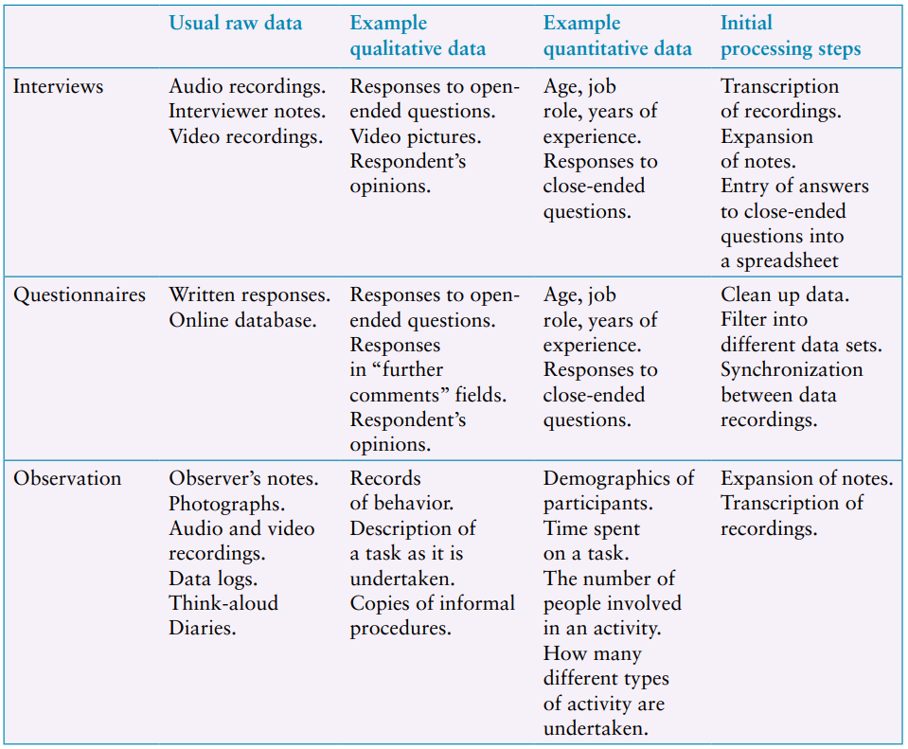
1st Step in Analyzing Data

Slide 6
Why perform any
Analysis
Right after Data Collection ?
Get initial expressions of data
To see some overall patterns or trends illustrated by data

Slide 7
Quantitative Analysis
Percentages
Percentages are useful for standardizing the data, particularly to compare two or more large sets of responses.
Averages
Mean refers to the commonly understood interpretation of average
Median is the middle value of the data when the numbers are ranked.
Mode is the most commonly occurring number

Slide 8

How Question Design Affects Data Analysis
Example : http://memorymirror.com/

Slide 9
How Question Design Affects Data Analysis
Questions: “How do you feel about this new app?”
Responses to this will be varied and may include that it is cool, impressive, realistic, clunky, technically complex, and so on.
Alternative Question: “In your experience, are virtual try-on holographs realistic, clunky, or distorted?”
This clearly reduces the number of options and the responses would be recorded as “realistic,” “clunky,” or “distorted.”

Slide 10
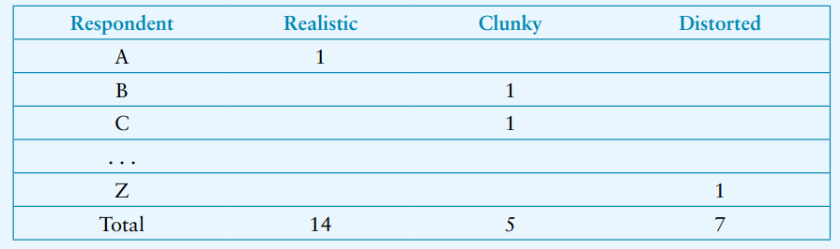
How Question Design Affects Data Analysis
Simple table, initial analysis of this data might look like the following:
** Protect participants’ privacy by anonymizing the name

Slide 11
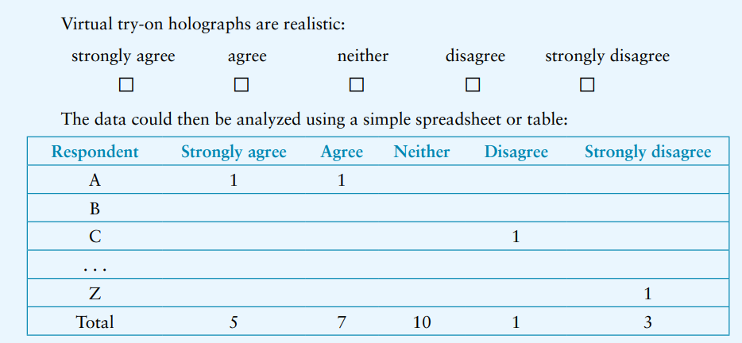
How Question Design Affects Data Analysis
Another alternative that might be used in a questionnaire is to phrase the question in terms of a Likert scale.

Slide 12
Basic Tools for Collation and Analysis
Examples of Quantitative Analysis:
A/B testing
T-test analysis
Z-test analysis
Chi-square test analysis
Excel and Google Sheets
offers a variety of numerical manipulations and graphical representations.

Slide 13
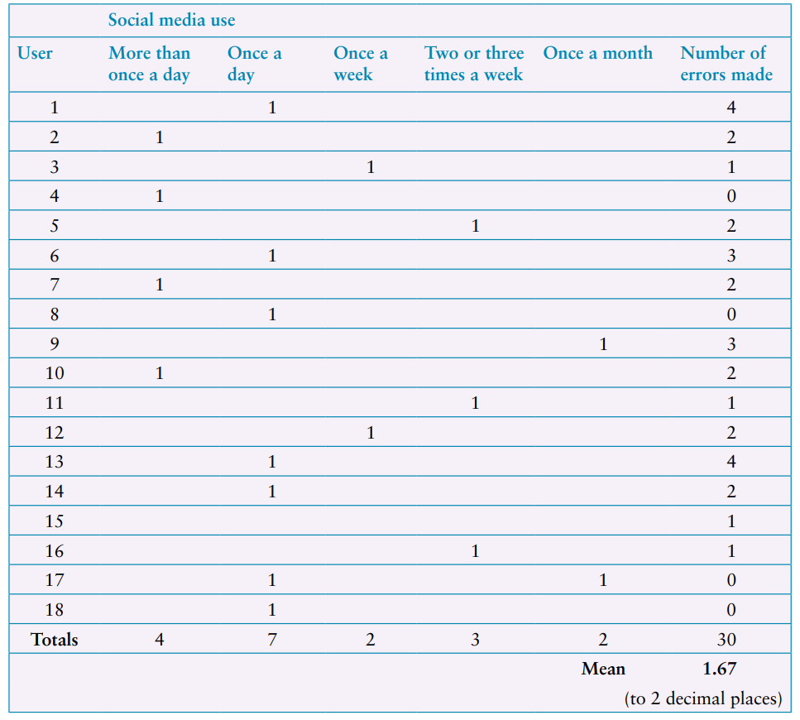
Presentations
Example: Data gathered during a study of a photo sharing app

Slide 14
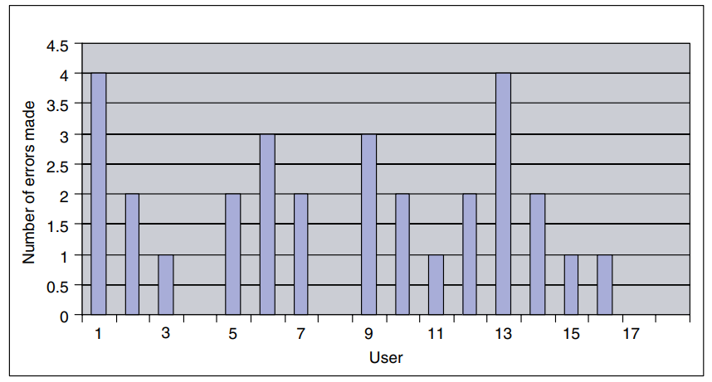
Presentations

Slide 15
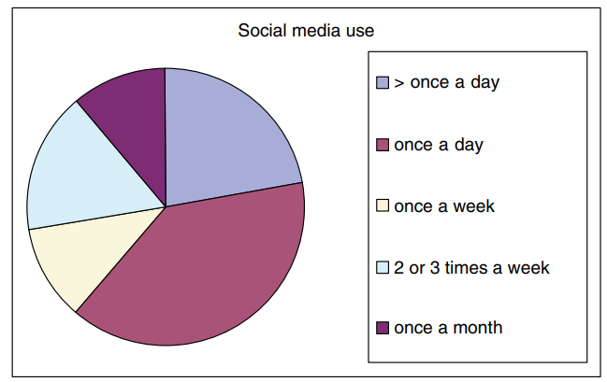
Presentation

Slide 16
Outliers
Outliers : values that are significantly different from the majority, and hence not common.
Outliers are usually removed from the main data set because they distort the general patterns.
However, outliers may also be interesting cases to investigate further in case there are special circumstances surrounding those users and their session.

Slide 17
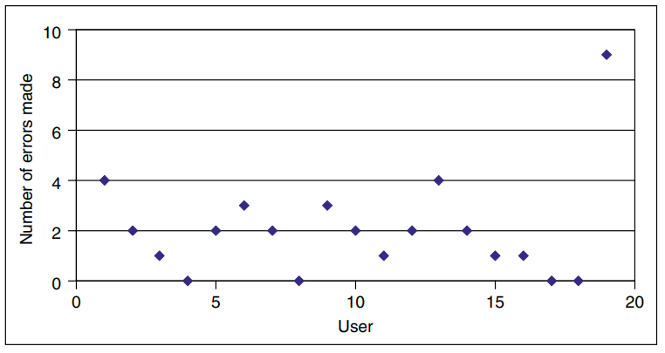
Presentation
Using a scatter diagram helps to identify outliers in your data quite quickly

Slide 18
Example 1
The data in the following table represents the time taken for a group of users to select and buy an item from an online shopping website
User | A | B | C | D | E | F | G | H | I | J | K | L | M | N | O | P | Q | R | S
Time | 15 | 10 | 12 | 10 | 14 | 13 | 11 | 18 | 14 | 17 | 20 | 15 | 18 | 24 | 12 | 16 | 18 | 20 | 26

Slide 19
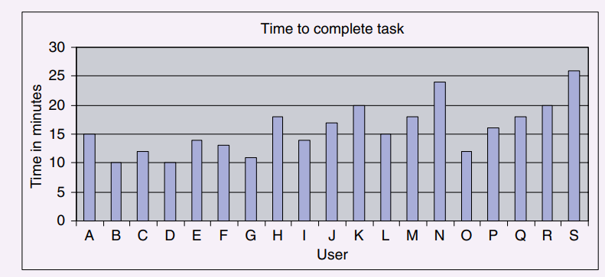
Example 1 – Bar Graph

Slide 20
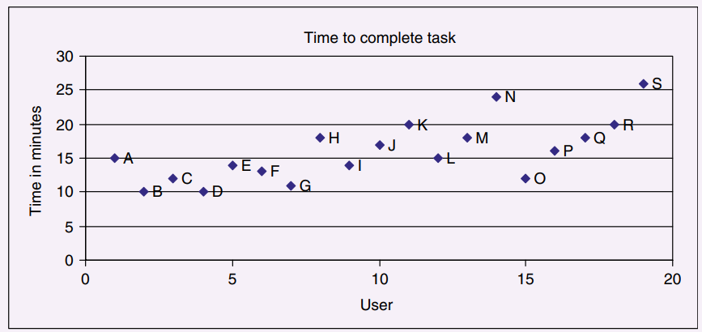
Example 1 – Scatter Diagram

Slide 21
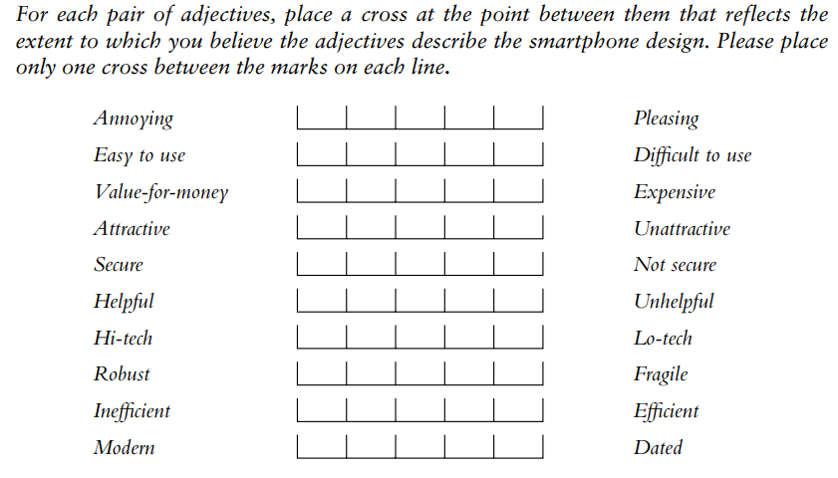
Example 2
The following question was asked in a questionnaire to evaluate two different smartphone designs:

Slide 22
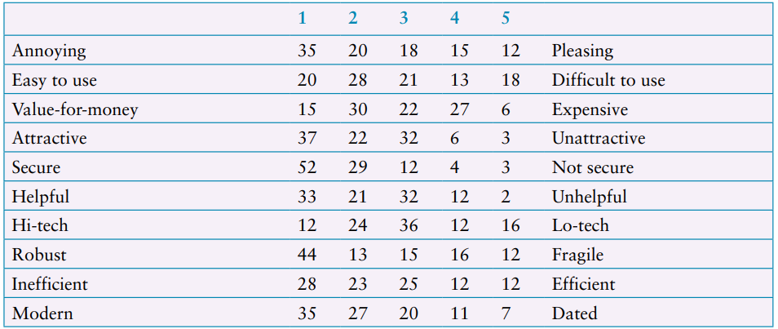
Example 2 – Phone 1

Slide 23
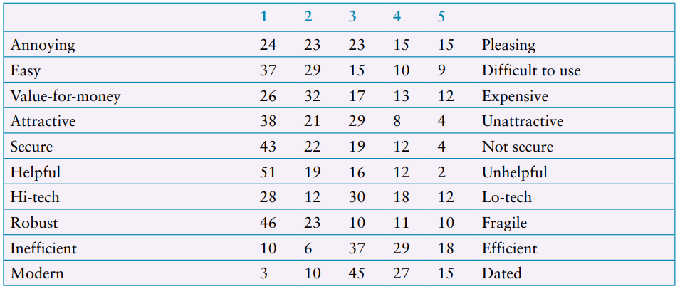
Example 2 – Phone 2

Slide 24
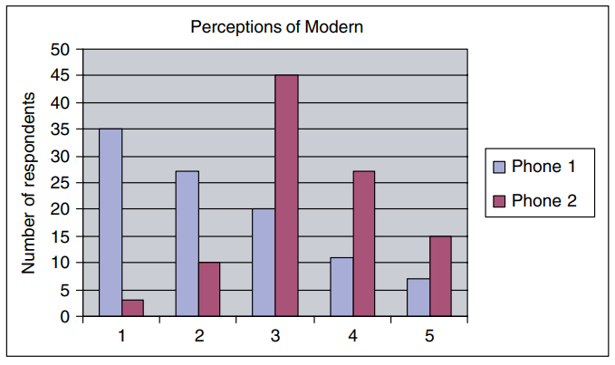
Example 2 – Bar Graph
A graphical comparison of two smartphone designs according to whether they are perceived as modern or dated.

Slide 25
Qualitative Analysis
Gain an overall impression of the data and to start looking for interesting features, topics, repeated observations, or things that stands out.
It is important to confirm and re-confirm findings to make sure that initial impressions don’t bias analysis.

Slide 26
Qualitative Analysis
Three basic approaches to qualitative analysis
identifying themes
categorizing data
analyzing critical incidents
Critical incident analysis is a way to isolate subsets of data for more detailed analysis, perhaps by identifying themes or applying categories.

Slide 27
Qualitative Analysis
Inductive | Deductive
Themes or categories are developed by going through the data
Established categories are applied to the data

Slide 28
Identify Themes
Theme
A pattern of some kind
e.g. a particular topic coming up again and again when going through interviews.
Thematic Analysis
widely used analytical technique that aims to identify, analyse, and report patterns in the data.
Themes should be relevant to the study goal

Slide 29





Conducting Thematic Analysis
1
Collect Data
3
Generate Initial codes
5
Review and Refine Themes
2
Familiarize yourself with data
4
Identify
Themes

Slide 30

Interview 1 – Alice (Pet Owner, Age 32)
Interviewer: Can you describe your experience using our website? Alice: It looks nice, but it was a bit hard to find the exact pet food I wanted.
The search results weren’t very relevant.
Interviewer: What do you mean by "not relevant"? Alice: Well, I searched for "organic dog food," but I got a mix of cat and bird food as well. It was frustrating.
Interviewer: How was the checkout process for you? Alice: It took too long. I had to enter my address twice for some reason. I almost gave up.
Interviewer: Anything else that bothered you? Alice: Yes, the images took forever to load on my phone.
Codes
Search issues
Redundant steps on checkout
Slow loading for images
Interview transcript of a user regarding feedback of an online pet store

Slide 31
Interview 2 – James (Dog Trainer, Age 45)
Interviewer: How was your experience finding products on our site? James: Honestly, it was a bit confusing. The categories didn’t make sense, and I had to click through a lot of pages.
Interviewer: Did you use the search function? James: Yes, but it wasn’t helpful. When I searched for "grain-free dog treats," I got a mix of random products.
Interviewer: How did you find the checkout process? James: It was okay, but I didn’t like that I was forced to create an account. I just wanted to buy something quickly.
Interviewer: Any technical issues? James: Some buttons didn’t look clickable. I wasn’t sure if I was supposed to tap them or not.
Codes
Search issues
Redundant steps on checkout
Slow loading for images
4. Confusion navigation / organization
5. Forced account creation
6. Unclear UI elements
Interview transcript of a user regarding feedback of an online pet store

Slide 32

Interview 3 – Sarah (New Pet Owner, Age 27)
Interviewer: Tell me about your experience on the website. Sarah: It was overwhelming at first. There were too many options, and I didn’t know where to start.
Interviewer: How did you search for products? Sarah: I used the search bar, but it didn’t help much. It gave me results that didn’t match what I was looking for.
Interviewer: What about the checkout process? Sarah: It was long. I had to enter my details multiple times, which was annoying.
Interviewer: Any other issues? Sarah: The images loaded very slowly, which made browsing frustrating.
Codes
Search issues
Redundant steps on checkout
Slow loading for images
4. Confusion navigation / organization
5. Forced account creation
6. Unclear UI elements
7. Overwhelming UI
Interview transcript of a user regarding feedback of an online pet store

Slide 33
Codes:
1.Search issues
2.Redundant checkout steps
3.Slow loading time
4.Confusing navigation
5.Forced account creation
6.Unclear UI elements
7.Overwhelming UI
group similar codes into broader themes
Theme | Related Codes
Search & Navigation Issues | Search issues, Confusing navigation
Checkout Frustrations | Redundant checkout steps, Forced account creation
Performance Issues | Slow loading time
UI & Usability Problems | Unclear UI elements, Overwhelming UI

Slide 34
Thematic Analysis
Inductive Analysis
Identify themes
Performed iteratively
Determine meaningful code that are orthogonal
Decide appropriate granularity

Slide 35

Affinity Diagrams
The approach seeks to organize individual ideas and insights into a hierarchy showing common structures and themes.
Notes are grouped
Groups emerged from the data
Diagram start from one note

Slide 36
Categorizing Data
In this procedure the analysis frame (the set of categories used) is chosen beforehand, based on the study goal.
In that case, analysis proceeds deductively.

Slide 37
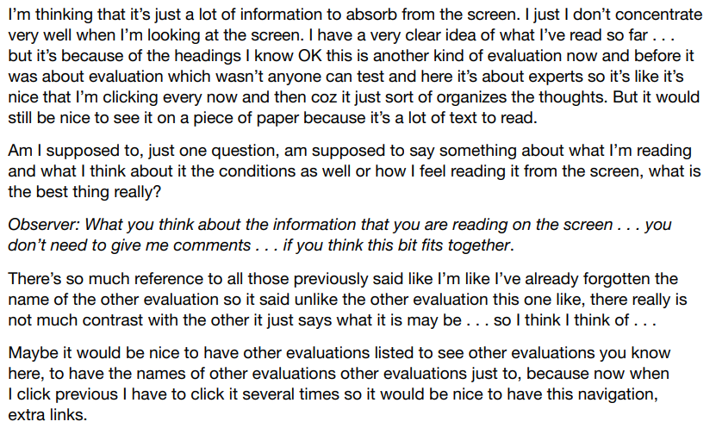
Example
Excerpt from a transcript of a think-aloud protocol when using an online educational environment.

Slide 38
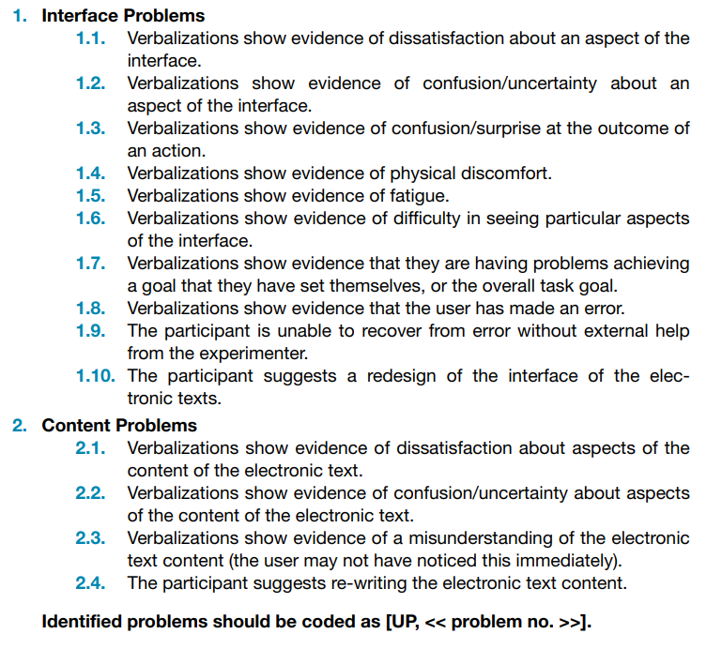
Example
Criteria for identifying usability problems from verbal protocol transcriptions

Slide 39
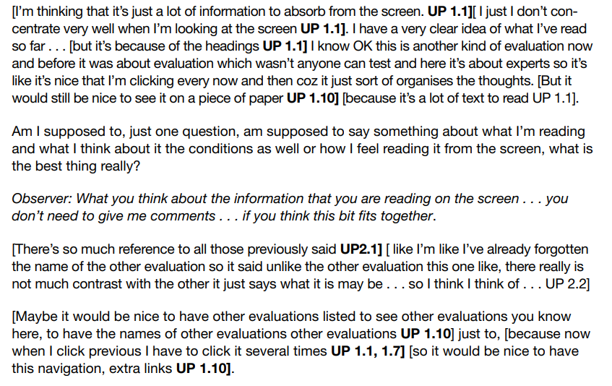
Example
The excerpt on Slide 31 coded using the categorization scheme on Slide 32

Slide 40
Critical Incident Analysis
Critical incident analysis is one approach that helps to identify significant subsets of the data for more detailed analysis.
It has two basic principles:
reporting facts regarding behaviour is preferable to the collection of interpretations, ratings, and opinions based on general impressions.
reporting should be limited to those behaviours which, according to competent observers, make a significant contribution to the activity.

Slide 41
Critical Incident Analysis
In the interaction design context, the use of well-planned observation sessions satisfies the first principle.
The second principle refers to critical incidents, that is, incidents that are significant or pivotal to the activity being observed, in either a desirable or an undesirable way.

Slide 42
Critical Incident Analysis
Traditionally focus on investigating cause of human-system problem to minimize loss of life, property , money or data
The investigator may focus on a particular incident or set of incidents which caused serious loss
Nowadays used for other types of investigations as well in designing . Examples

Slide 43





Conducting Critical Incidence Analysis
1
Preparation
Arrange Interviews
Requests reports
Develop surveys
Prepare instructions for participants
3
Gather facts
Interview individuals who had experienced issue or have observed others who have experienced issue
Types of questions
5
Interpret
Develop some possible explanation of events
2
Obtain Materials
Obtain reports , records , accounts from from safety departments , insurance companies or regulatory or other bodies
4
Analysis
Record events and descriptions digitally
Analyse the frequence and conditions of events
Create categories of events and organize events
Note any items (e.g. display on a control panel) along with events

Slide 44
Analytical Frameworks
There are six different analytical frameworks
Can be used to analyze and interpret data from a qualitative study
Differ in terms of their granularity, that is, the level of detail involved.

Slide 45
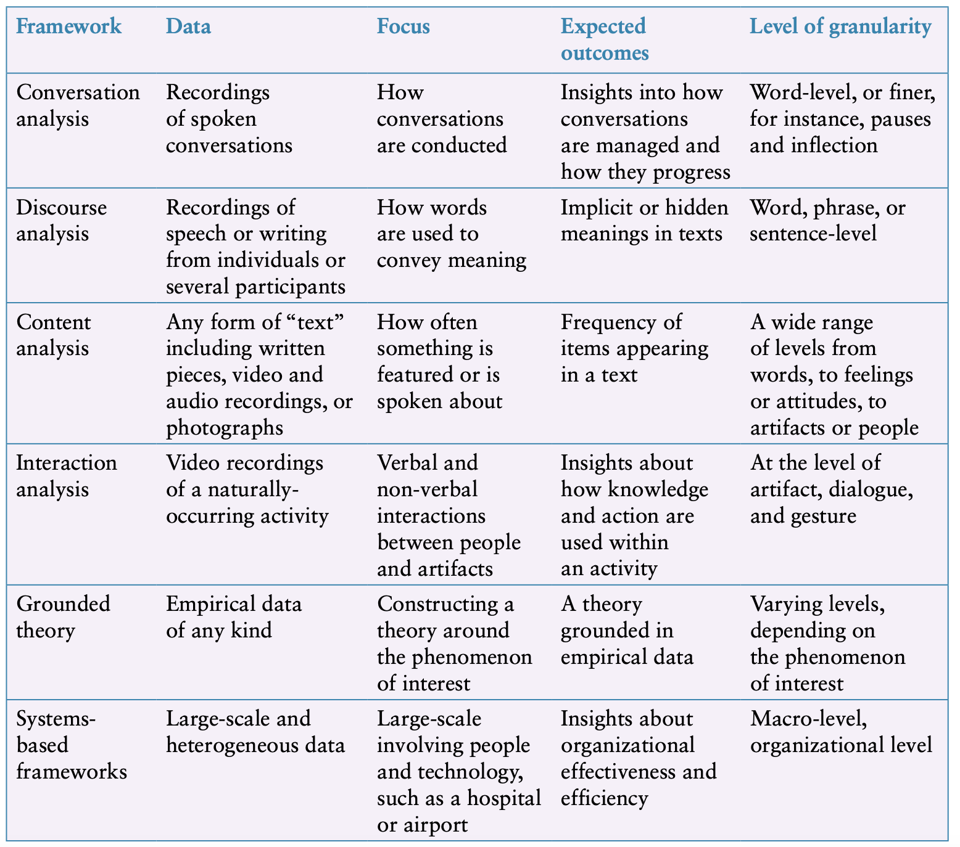

Slide 46
Conversation analysis (CA)
Conversation analysis (CA) examines the semantics of a conversation in fine detail
The focus is on how a conversation is conducted
how conversations start and how turn-taking is structured
used to analyze interactions in a range of settings
has influenced designers’ understanding of users’ needs in their environments

Slide 47
Example
It can also be used to compare conversations that take place through different media
for example, face-to-face conversations versus those conducted through social media.
More recently, it has been used to analyze the conversations that take place with voice-assisted technologies and chatbots
Voice assistants (also called smart speakers), like Amazon Echo

Slide 48
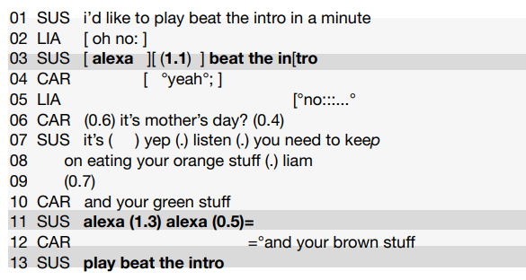
Example
An extract of the conversation between the family and Alexa, marked up for conversation analysis
Source: Porcheron et al. (2018), fragment 1. Reproduced with permission of ACM Publications

Slide 49
Discourse Analysis
Discourse analysis focuses on dialogue
the meaning of what is said and how words are used to convey meaning
Discourse analysis is strongly interpretive
pays great attention to context
and views language not only as reflecting psychological and social aspects but also as constructing them
discourse analysis provides a way of focusing on how people use language to construct versions of their worlds
underlying philosophy of discourse analysis is similar to that of ethnography

Slide 50
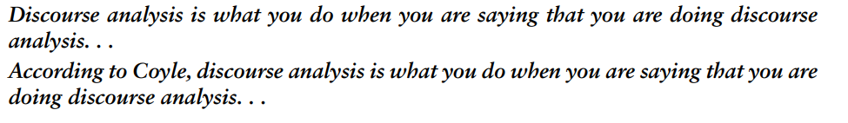
Example
Discourse analysis is useful
when trying to identify subtle
and implicit meaning in what people are writing about
what is trending
what is fake news, and so on

Slide 51
Content Analysis
Content analysis typically involves classifying the data into themes or categories and then studying the frequency of category occurrences
The technique can be used for any text
where “text” refers to a range of media including video, newspapers, advertisements, survey responses, images, sounds
It can be used to analyze any online content
including the text of tweets, links, animated gifs, videos, and images.
It considers wider context

Slide 52
Example
Mark Blythe and Paul Cairns (2009) analyzed 100 videos from a YouTube search by relevance for “iPhone 3G” using content analysis.
They categorized the videos into seven categories:
review, reportage, “unboxing,” demonstration, satire, advertisement, and vlog commentaries (such as, complaints about queues)

Slide 53
Interaction Analysis
Interaction analysis is a way of investigating and understanding the interactions of human beings with each other and objects in their environment.
It is based on video recordings
This technique focuses on both talk and nonverbal interactions with artifacts and technologies
Interaction analysis is an inductive process
interaction analysis is conducted collaboratively by a team of researchers

Slide 54
Example
Anna Xambo et al.’s (2013) study of how groups of musicians improvise and learn to play together when using a novel collaborative tabletop technology.
Video data was collected
Representative video extracts were repeatedly viewed and discussed by a team of researchers
These themes were categorized into whether they were musical, physical, or interface-related

Slide 55
Grounded Theory
The goal of grounded theory is to develop theory from a systematic analysis and interpretation of empirical data
that is, the derived theory is grounded in the data
It is an inductive approach to developing theory
Theory is: “a set of well-developed concepts related through statements of relationship, which together constitute an integrated framework that can be used to explain or predict phenomena”

Slide 56
Steps
first data is collected and analyzed to identify themes (coding)
then that analysis may lead to further data collection and analysis
refine the themes, and so on
This approach continues until no new insights emerge and the theory is well-developed.

Slide 57
Coding
Open coding is the process through which categories, their properties, and dimensions are discovered in the data.
Axial coding is the process of systematically fleshing out categories and relating them to their subcategories.
Selective coding is the process of refining and integrating categories to form a larger theoretical scheme.

Slide 58
System Based Framework
For large projects where the researcher is interested in investigating
how a new technology should best be introduced
and what its impact is afterward
It is necessary to analyze many sources of data collected over a long period of time.
Two such frameworks are introduced next
Socio-technical systems theory
Distributed Cognition of Teamwork framework

Slide 59
Socio-technical Systems Theory
Socio-technical systems (STS) theory makes explicit the fact that the technology and the people in a work system are interdependent
There five significant and enduring aspects of STS theory
Task interdependencies
Socio-technical systems are “open systems
Heterogeneity of system components
Practical contributions
Fragmentation of design processes

Slide 60
Distributed Cognition of Teamwork
“Cognitive Aspects,” as an approach to studying the nature of cognitive phenomena across individuals, artifacts, and internal and external representations.
Investigating how information is propagated through different media is a key goal of this approach
While distributed cognition provides a good theoretical framework for analyzing systems, it can be difficult to apply in practice

Slide 61
Models of DiCoT
Information Flow Model
Physical Model
Artifact Model
Social Structure Model
System Evolution Model

Slide 62
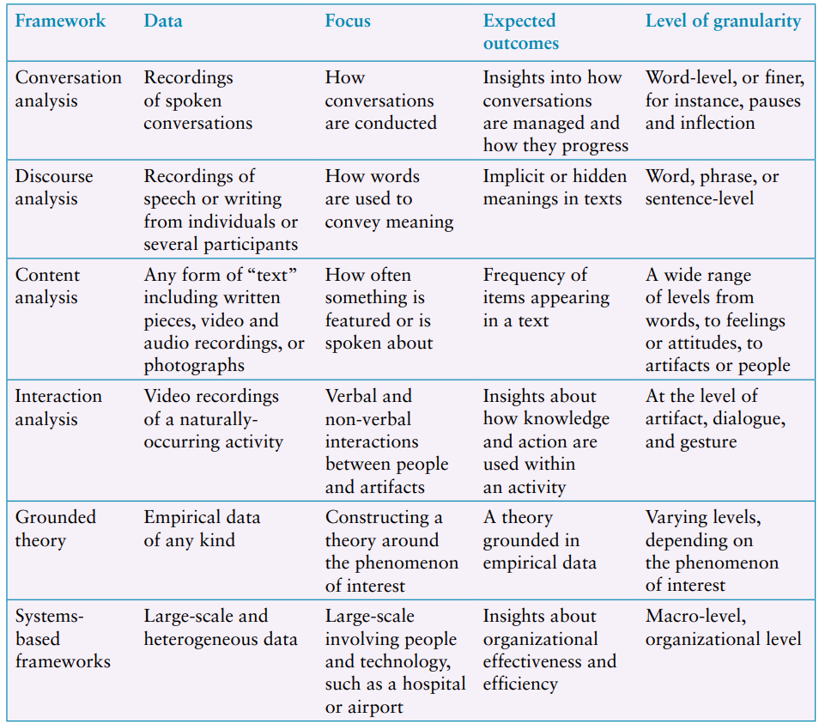
Which Kind of Analytic Framework to Use?
Overview of analytical frameworks used in interaction Design

Slide 63
Tools to Support Data Analysis
Nvivo
Nvivo supports the annotation and coding of data including PDF documents, photos, and video and audio files
Dedoose
Statistical Analysis Software (SAS) and Statistical Package for the Social Sciences (SPSS)
are popular quantitative analysis packages that support the use of statistical tests.

Slide 64
Interpreting and Presenting the Findings

